Slide 1
Process Flow Diagram
Booster Compressor
Residue After cooler
Reflux Exchanger
Expander
Cold Separator
Sub Cooler
Residue Gas
Inlet Gas
Residue Compressor
Reflux Separator
Inlet Separator
Reboilers
Demethanizer
NGL

Slide 2
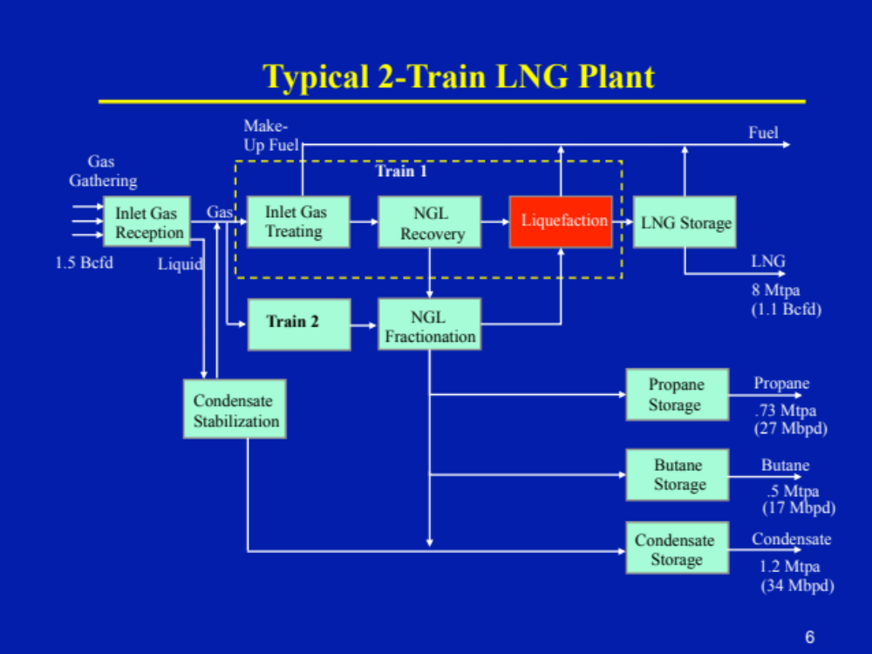

Slide 3
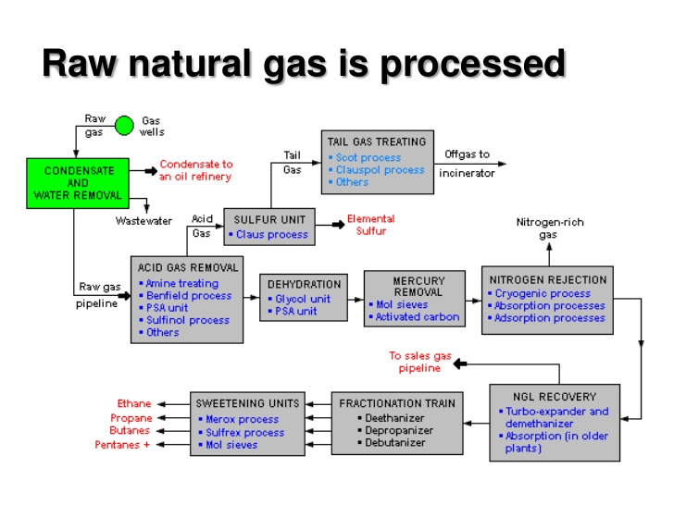

Slide 4
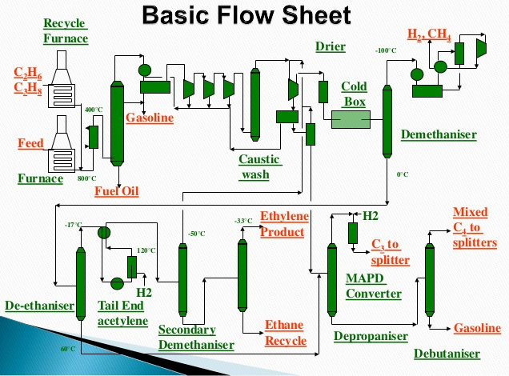

Slide 5
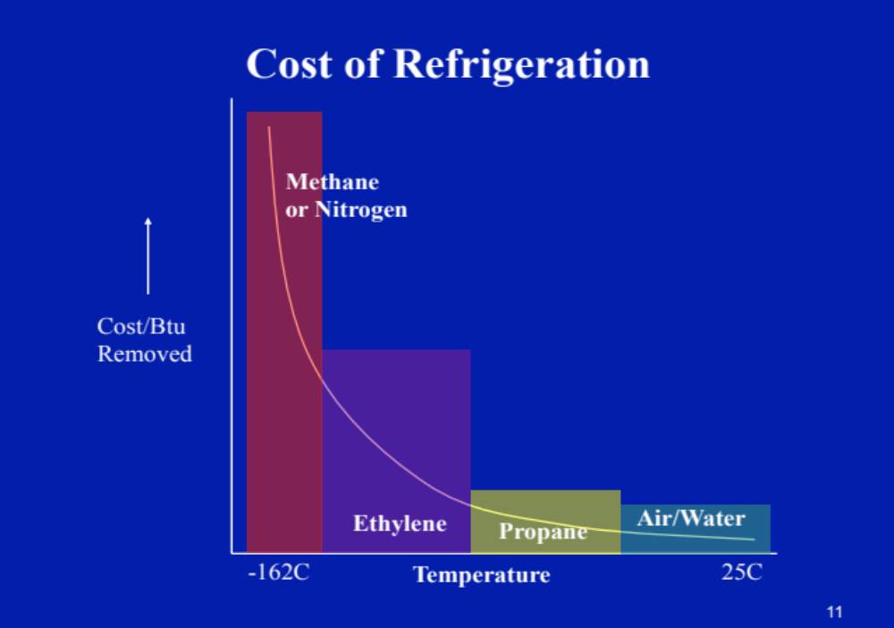

Slide 6
